Slide 1
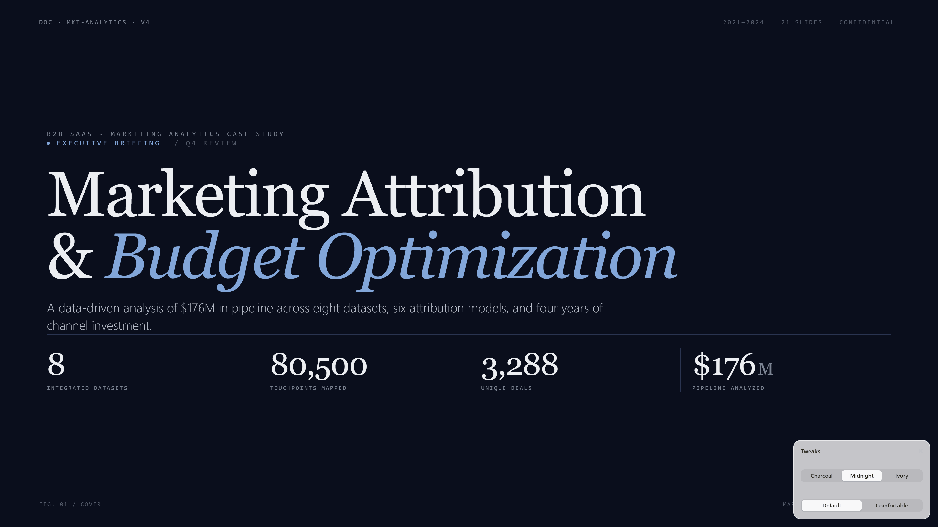
Notes:
Welcome. This deck walks through a marketing attribution and budget optimization analysis for a B2B SaaS company. We integrated 8 datasets, mapped 80,500 touchpoints across 3,288 unique deals representing $176M in pipeline from 2021 through 2024, and applied 6 attribution models. The goal is simple: tell you what marketing's actually contributing, and where budget should move next quarter.

Slide 2
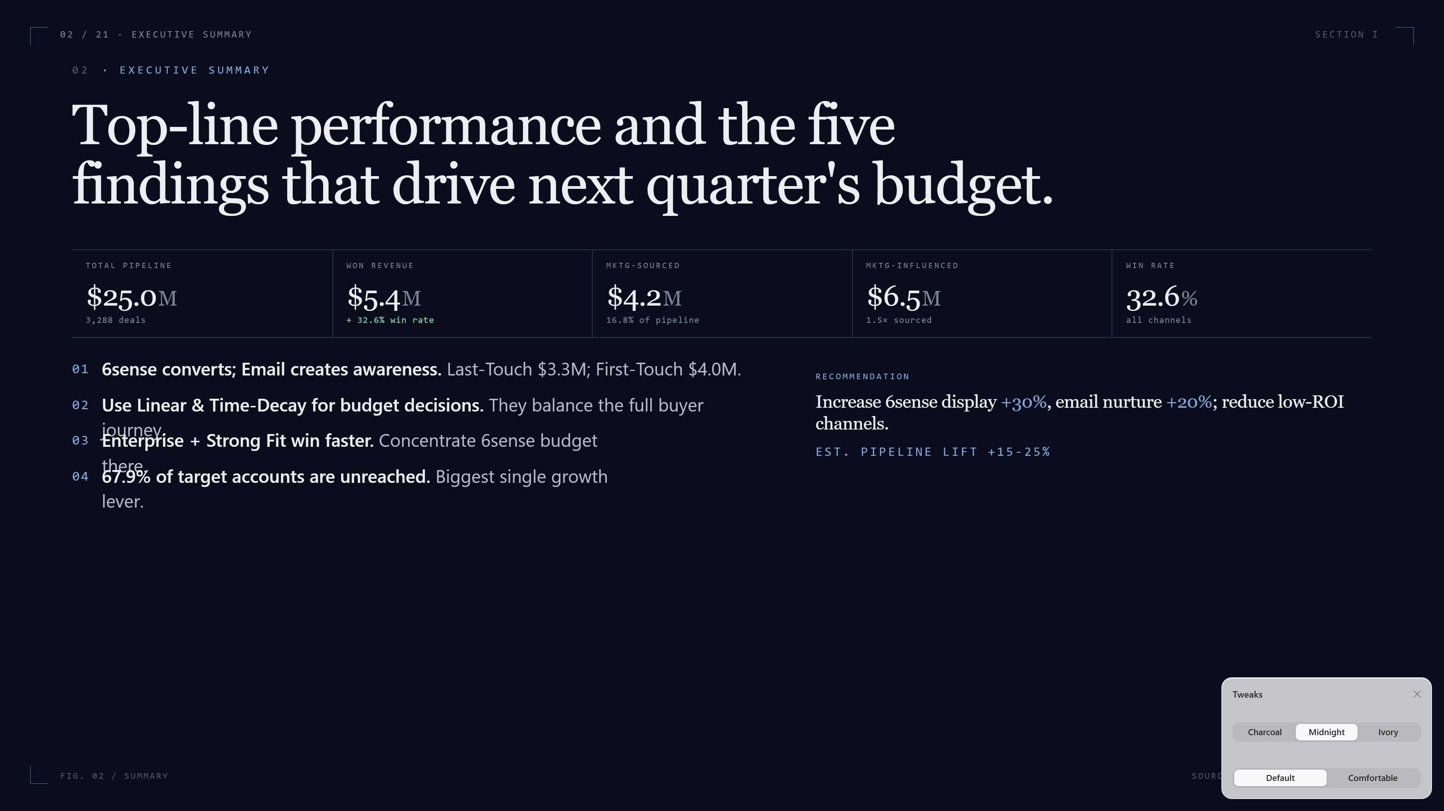
Notes:
Top line: $25M in pipeline, $5.4M won, with marketing sourcing $4.2M and influencing another $6.5M. The headline win rate is 32.6%, but that hides important variation. The five highlighted findings below are what we'll spend the rest of the deck unpacking — but if you take only one thing away, it's that 6sense Display and Email play different roles in the funnel, and the budget should fund both. We're recommending +30% on 6sense display, +20% on email nurture, with a projected 15-25% pipeline lift.

Slide 3
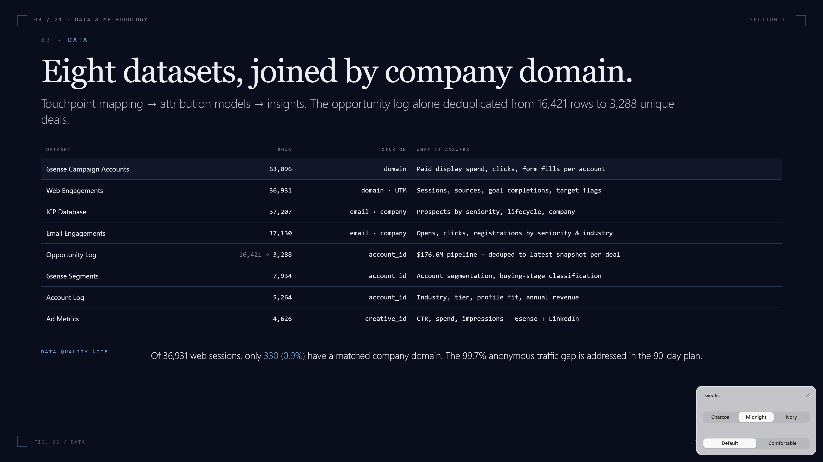
Notes:
Quick note on data foundation. We pulled from 8 sources: 6sense campaign accounts, ad metrics, email engagements, web analytics, the account log, opportunity log, ICP database, and 6sense segments. All linked through company domain. Two important data quality notes: the opportunity log dropped from 16,000 rows to 3,288 unique deals after deduplication — that was critical. And of 36,931 web sessions, only 330 had a matched company domain. Fixing that anonymous-traffic gap is in our 90-day recommendations.

Slide 4
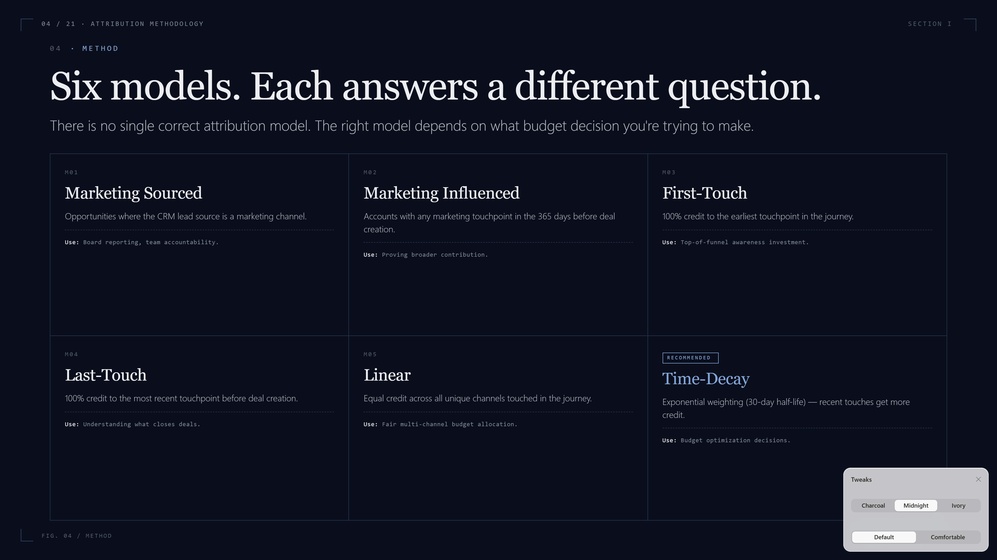
Notes:
We applied six attribution models because there is no single right answer — each one answers a different business question. Marketing Sourced and Influenced are the executive reporting lenses. First Touch, Last Touch, Linear, and Time-Decay split credit across the journey. For budget decisions, we recommend Time-Decay — it weights recent touches but doesn't ignore the early ones. For awareness investment decisions, use First-Touch.

Slide 5
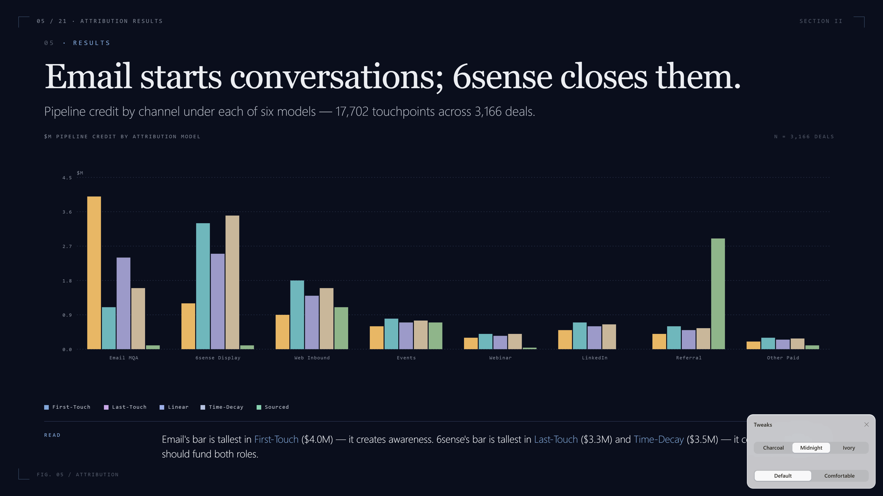
Notes:
Here's the punchline of the entire attribution exercise on one chart. Email dominates First-Touch — it starts conversations, $4 million attributed there. 6sense Display dominates Last-Touch and Time-Decay — $3.3 to $3.5 million. They're different jobs. Email finds and warms accounts; 6sense keeps the brand visible right when deals close. A channel that's tall in First-Touch and short in Last-Touch is an awareness channel. The budget mix should fund both roles, not pick a winner.

Slide 6
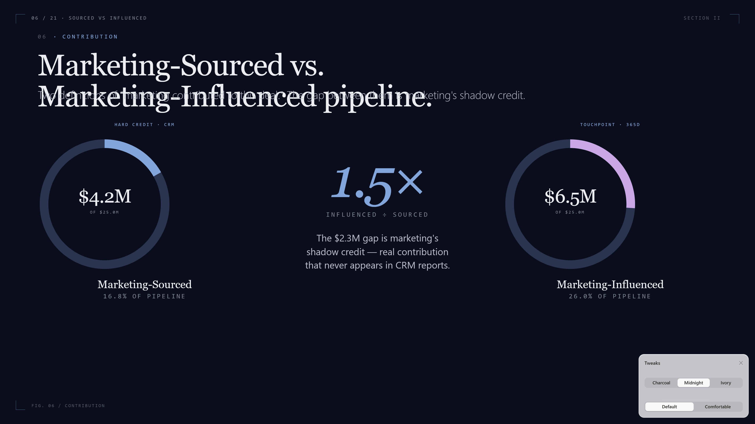
Notes:
Two ways to count marketing's contribution. Sourced — the CRM lead source field — is hard credit: $4.2M. Influenced — any marketing touch within 365 days before the deal — is $6.5M. The gap, $2.3M, is marketing's shadow credit: real contribution that never shows in the CRM. Influenced is 1.5x sourced. When the board asks 'what's marketing doing?' — the honest answer is somewhere between these two numbers.

Slide 7
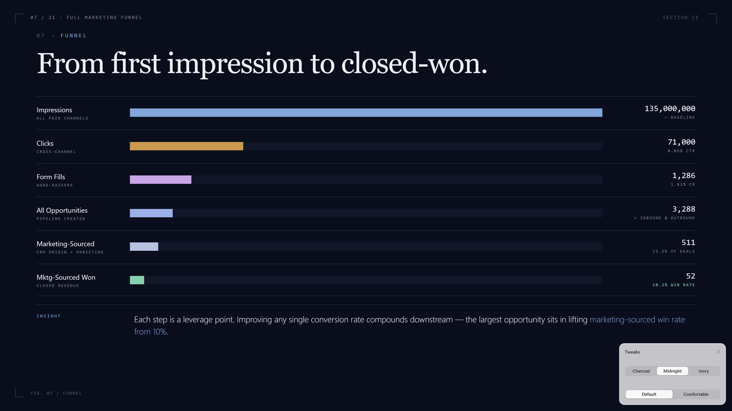
Notes:
The full funnel, end to end. 135 million impressions become 71,000 clicks become 1,286 form fills. Separately, the email channel produces 17,000 engagements. Both feed 3,288 deals, of which 511 are marketing-sourced and 52 ultimately close. Each step is a leverage point — improving any single conversion rate compounds downstream. The biggest opportunities are early: lifting click-to-form-fill, and lifting marketing-sourced win rate from 10%.

Slide 8
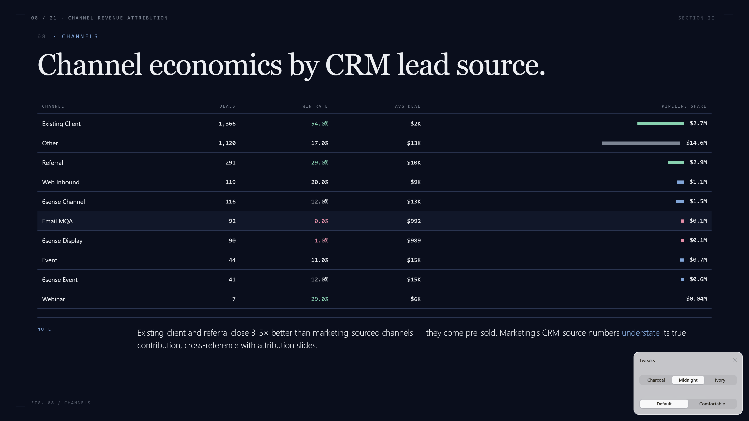
Notes:
Channel-level economics by CRM lead source. Existing client and referral close at 54% and 29% — far higher than any pure marketing channel — because those leads come pre-sold. That's expected and healthy. Where marketing has work to do is the 6sense and email channels, where win rates sit at 1-12%. Compare these CRM numbers against the attribution slides we just saw — channels small here, like 6sense, can be huge in influenced pipeline.

Slide 9
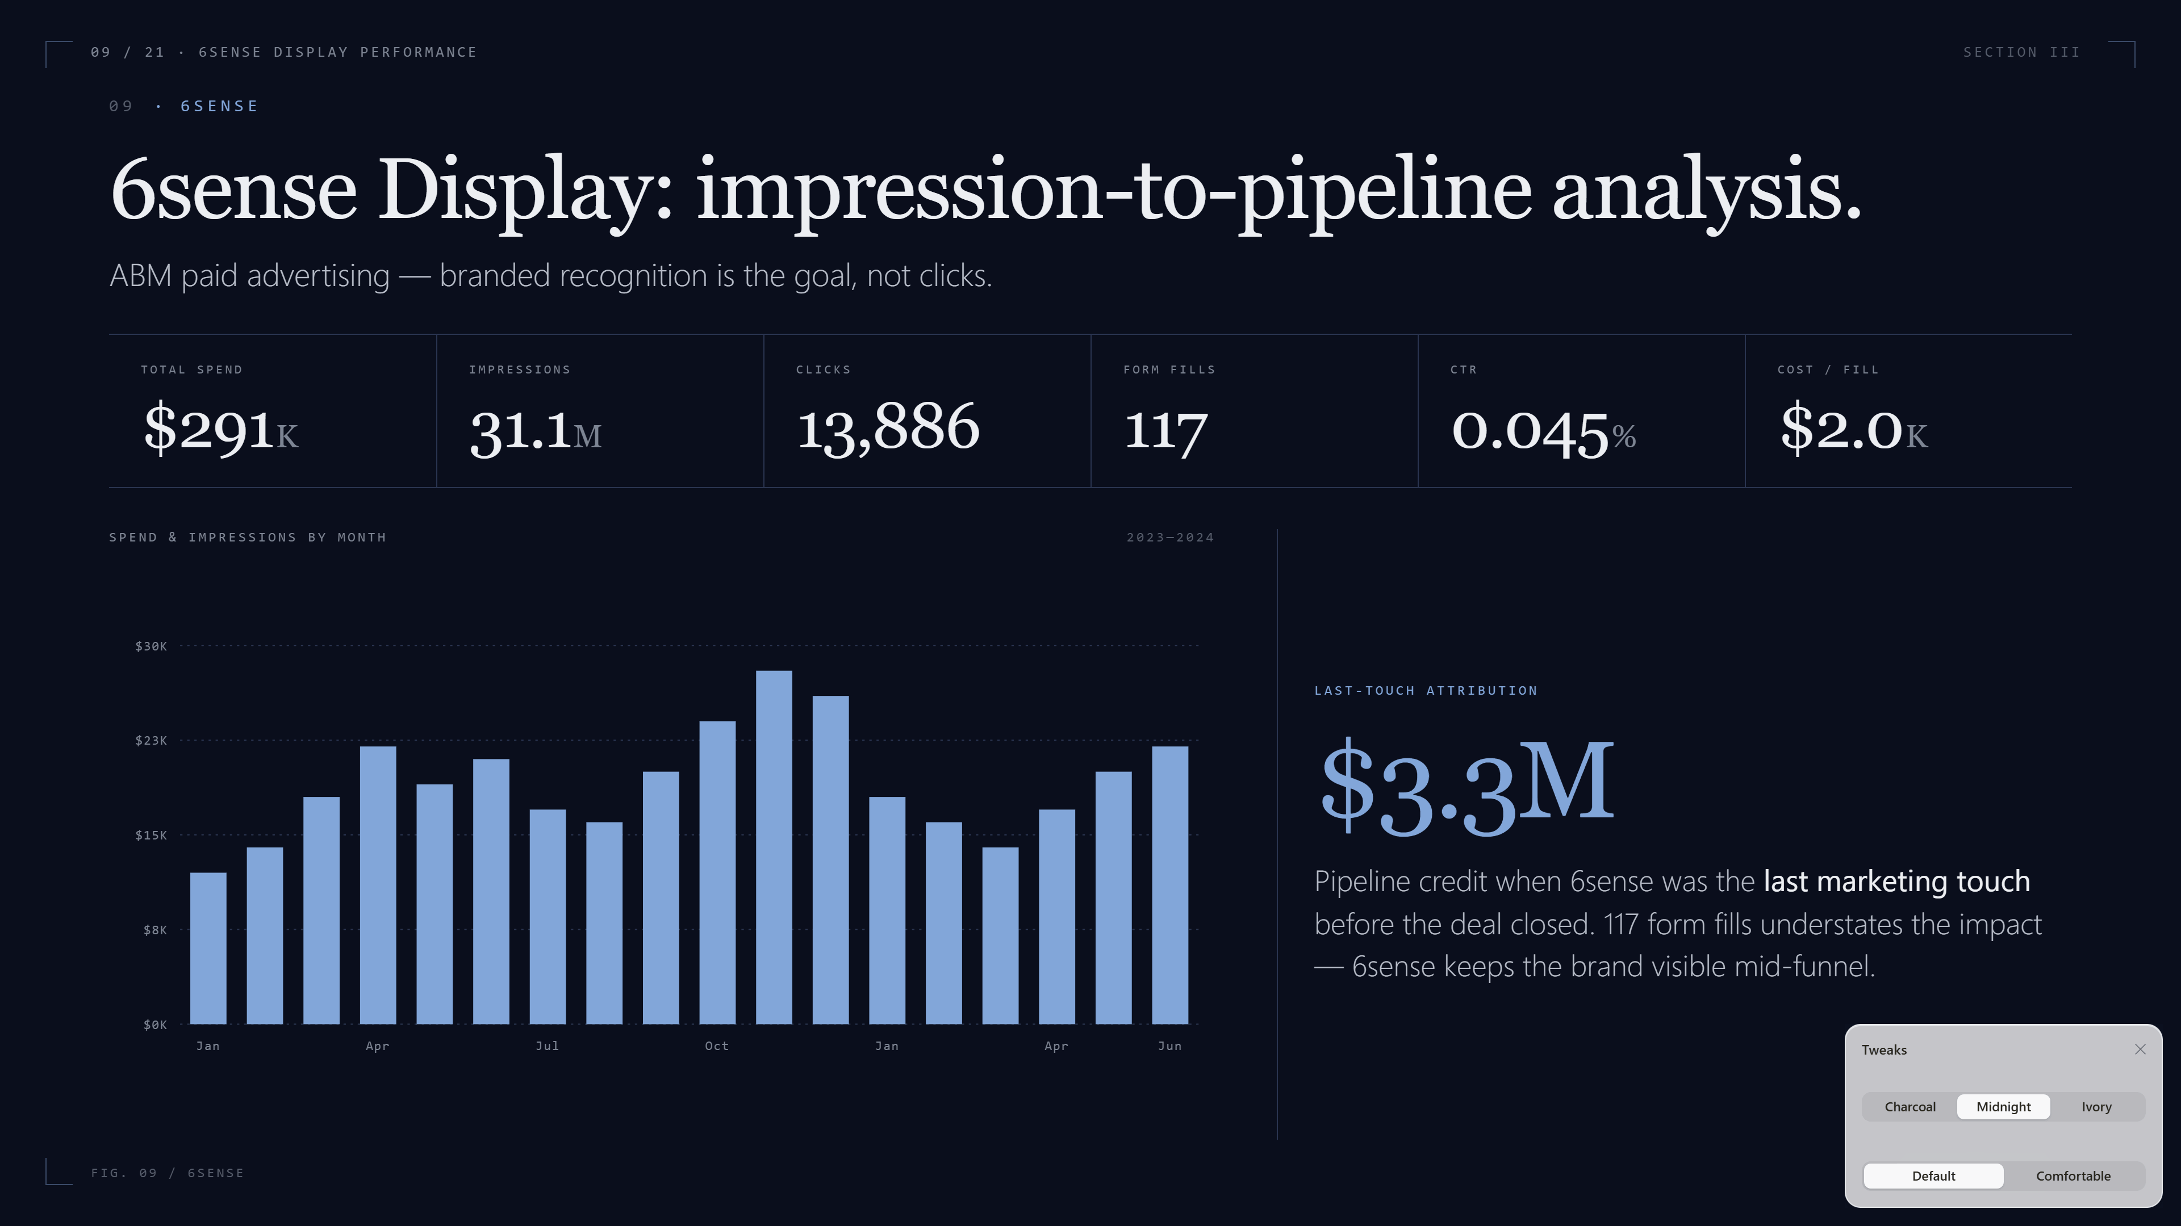
Notes:
6sense Display in detail. We spent $291,000 to generate 31 million impressions, 14,000 clicks, and 117 form fills. CTR of 0.045% — completely in-line with B2B display benchmarks; the goal isn't clicks. The real value is here: in Last-Touch attribution, 6sense gets $3.3M credit. It warms accounts so when sales calls, the brand is already familiar. Cost-per-form-fill of $2,000 looks expensive in isolation, but the influenced pipeline number is what justifies the spend.

Slide 10
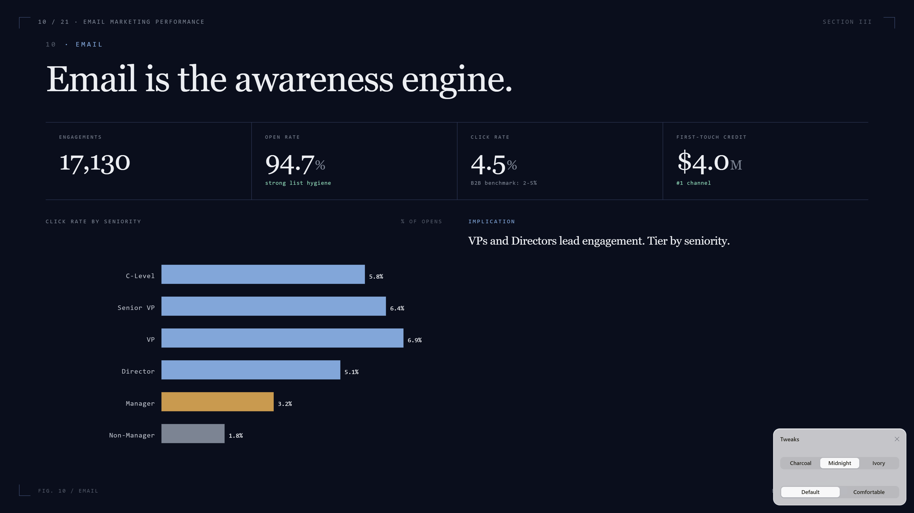
Notes:
Email is the awareness engine. 17,130 engagements, 94.7% open rate — that's unusually strong, suggests good list hygiene. Click rate of 4.5% is solid for B2B. Most importantly, email is the #1 First-Touch channel at $4.0M attributed. Look at the seniority breakdown: VPs and Directors are the most engaged. Manager-level audiences open less, click less. Implication: tier the email program — exec content for the top, more concrete content for the rest.

Slide 11
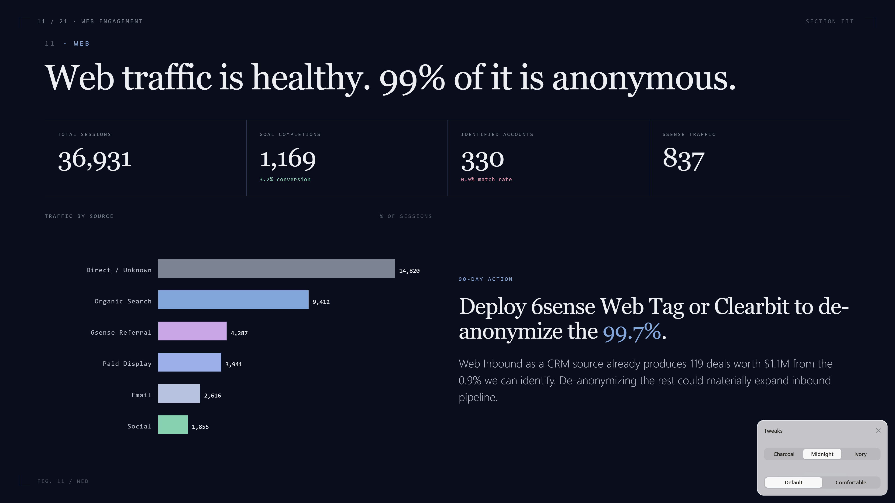
Notes:
Web analytics. 36,931 sessions, 1,169 goal completions — a healthy 3.2% conversion. But only 330 sessions have a matched company domain. 99% of web traffic is anonymous, which is the single largest data quality gap in the program. Web inbound as a lead source produces 119 deals worth $1.1M — that's clean signal. The 90-day recommendation is to deploy a de-anonymization layer, either 6sense Web Tag or Clearbit, to make the rest of this traffic actionable.

Slide 12
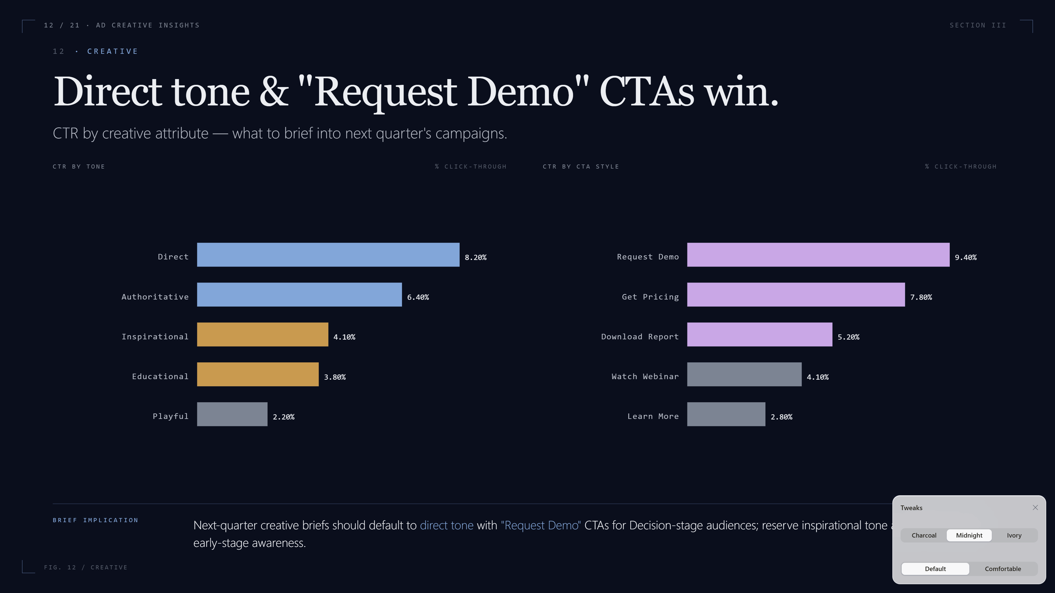
Notes:
Creative analysis. Two views: top individual ads on the left, and grouped attributes on the right — by tone, asset type, and CTA style. The grouped view is what's actionable for creative briefs. It tells you whether to brief 'direct' or 'inspirational' tone, what asset format works best, and whether soft CTAs like 'Learn More' beat hard CTAs like 'Request Demo' for this audience. Use this as the input to the next quarter's creative brief.

Slide 13
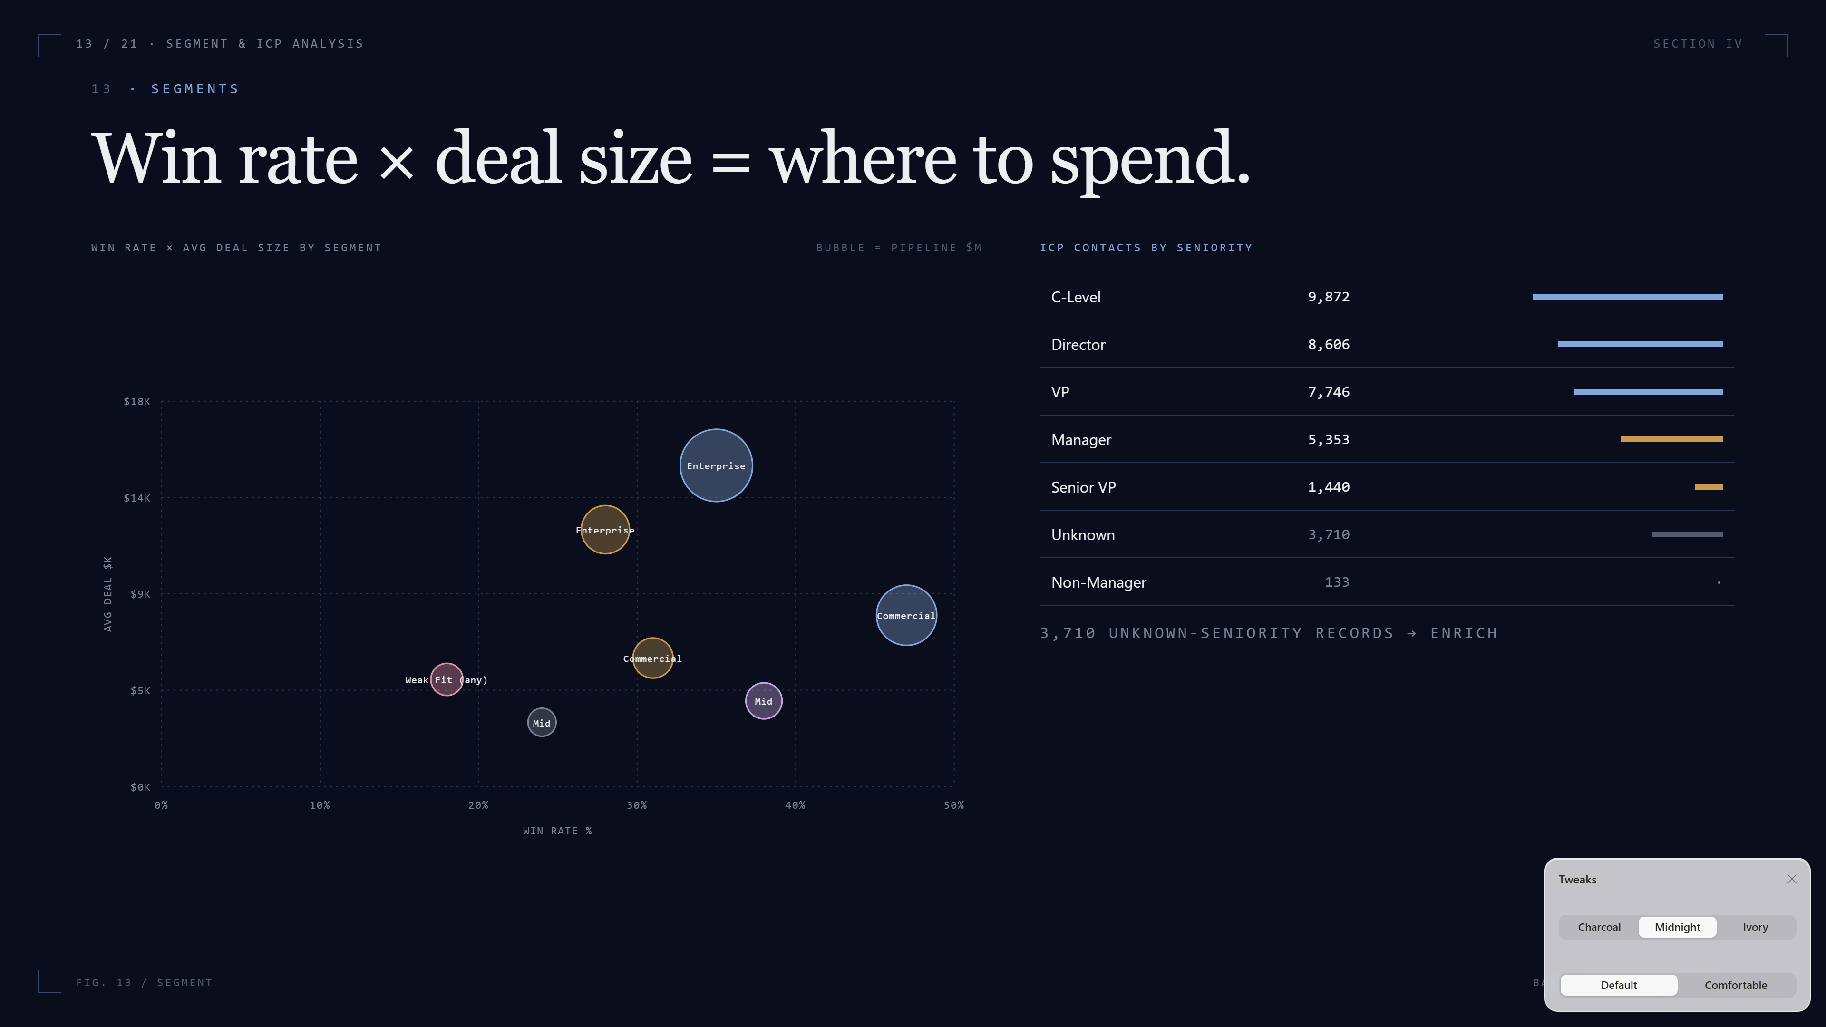
Notes:
Segment and ICP analysis. The math of ABM is win rate times deal size — that product is what determines where to put budget. Enterprise + Strong Profile Fit is the highest-value cell. The ICP contact breakdown on the right shows we have strong coverage at C-Level, Director, and VP — that's good — but a meaningful 'unknown seniority' bucket of 3,710 records that should be enriched.

Slide 14
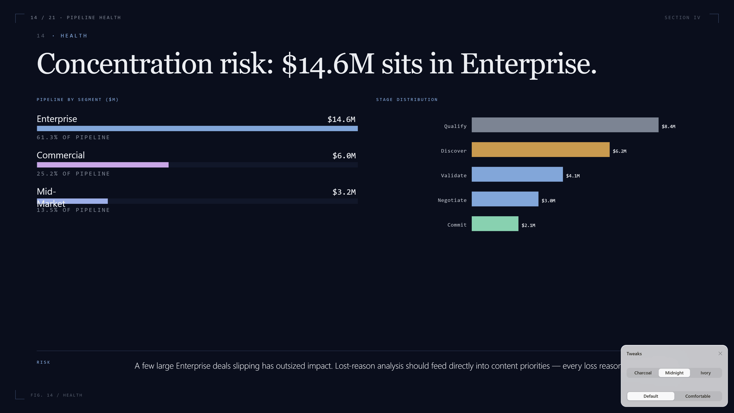
Notes:
Pipeline health snapshot. Most pipeline value sits in Enterprise — $14.6M of the $23.8M open pipeline. That's concentration risk: a couple of large Enterprise deals slipping has outsized impact. Stage distribution skews early; we need to nurture deals into late-stage. And lost reasons should feed directly into the content strategy — every loss reason is a content gap.

Slide 15
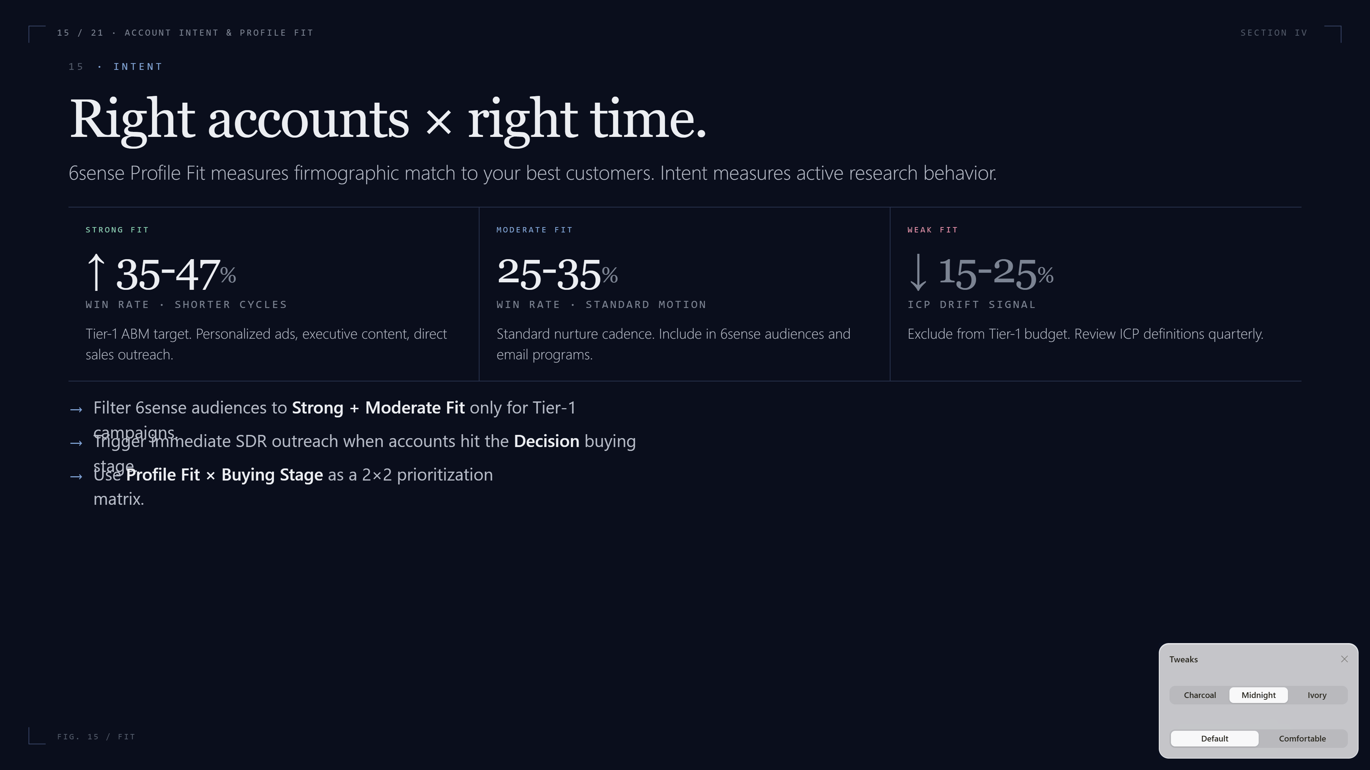
Notes:
Account intent and 6sense Profile Fit. Strong Profile Fit accounts close at higher rates and faster. The recommendation is straightforward: filter 6sense audiences to Strong + Moderate Fit only for Tier 1 campaigns, and trigger immediate SDR outreach when an account hits 'Decision' buying stage. Weak Fit accounts are a yellow flag — review the targeting criteria quarterly to make sure ICP definitions haven't drifted.

Slide 16
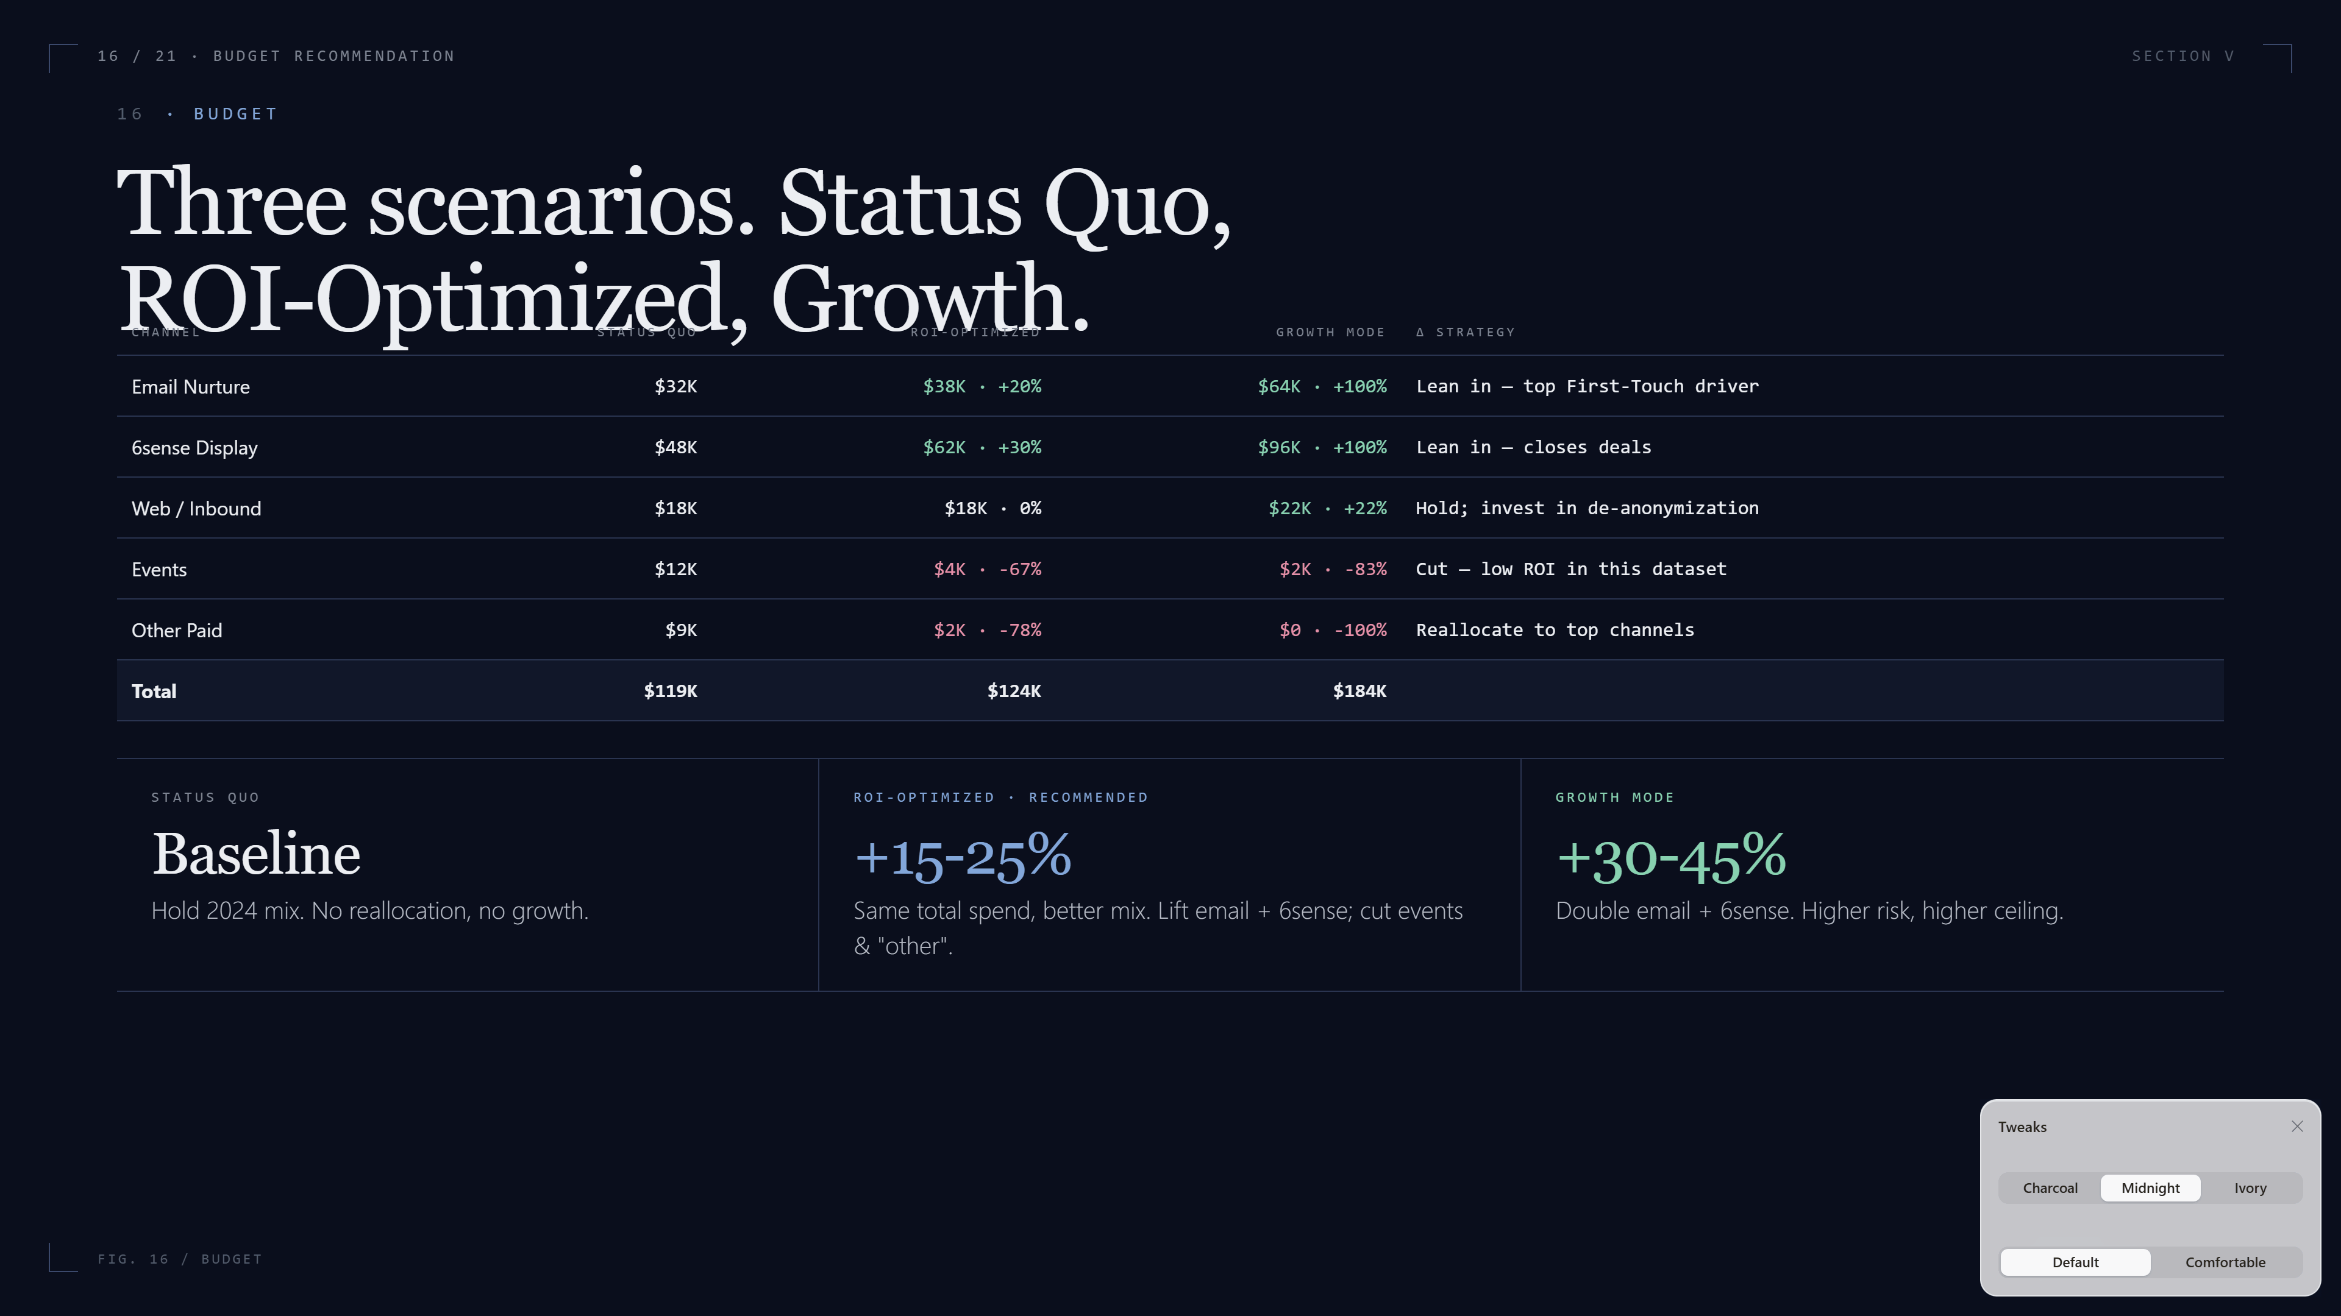
Notes:
Three budget scenarios. Status Quo at $119K — current allocation. ROI-Optimized at $124K reallocates toward high-ROI channels at roughly the same total spend. Growth Mode at $104K is more aggressive: double email and 6sense, halve everything else. The expected pipeline lift in ROI-Optimized is 15-25%. This is a directional model — diminishing returns are real — but the direction is reliable, and the test period should be one full quarter.

Slide 17
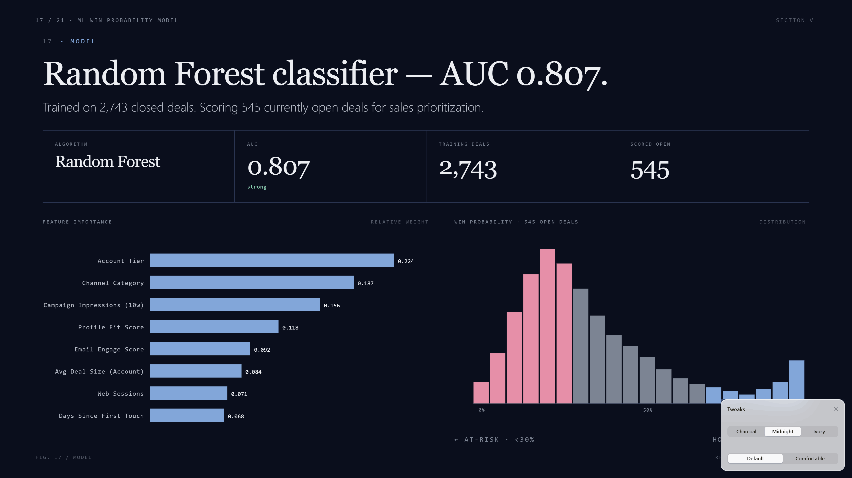
Notes:
We trained a Random Forest classifier on 2,743 closed deals. AUC of 0.807 is strong — that's a model worth listening to. Top predictors: account tier, channel category, and campaign impressions in the prior 10 weeks. The fact that ad impressions show up as a top predictor is direct validation of the ABM strategy — accounts marketing has reached more often actually do close more often. The 545 currently open deals are scored; share the top decile with sales weekly as a hot-deal list.

Slide 18
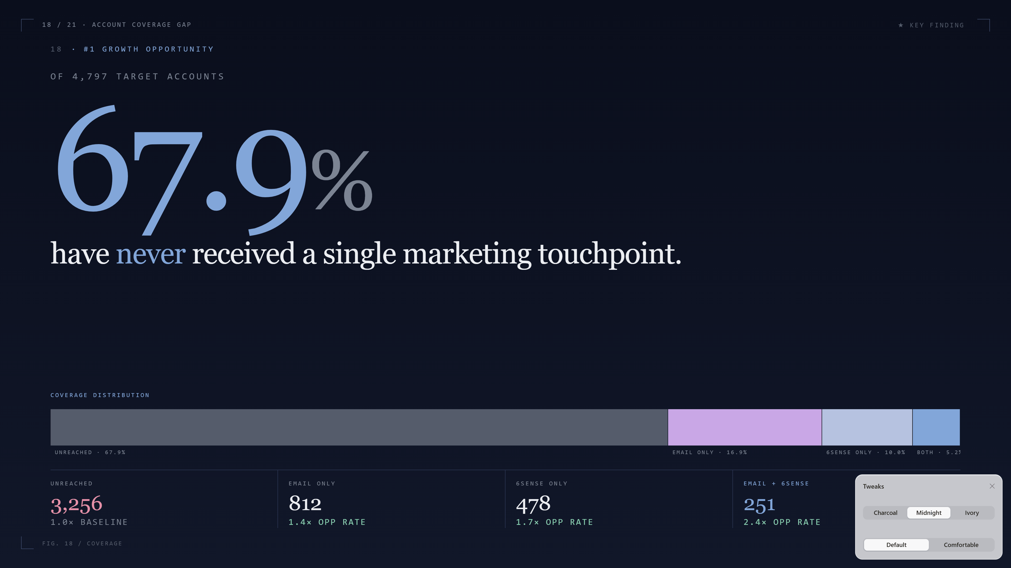
Notes:
This is the single biggest growth lever in the deck. Of 4,797 target account domains, 67.9% — 3,256 accounts — have never received a single marketing touchpoint. Zero. And accounts reached by both email AND 6sense show a 2.4x higher opportunity rate than unreached accounts. The next-quarter action is concrete: take the 3,256 unreached accounts, prioritize the Strong Profile Fit ones, and push them into a coordinated email plus 6sense sequence.

Slide 19
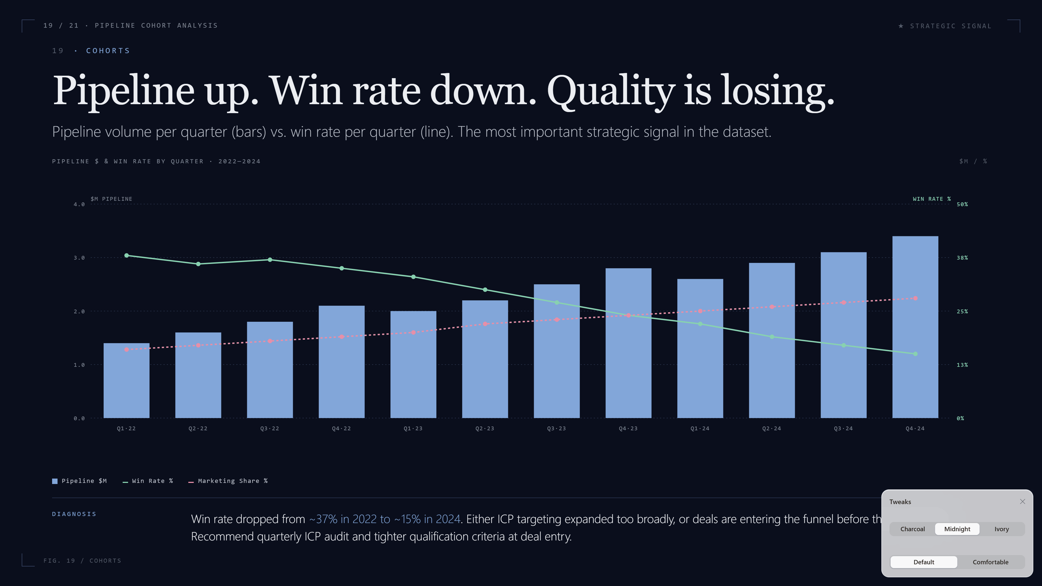
Notes:
This is the most important strategic signal in the dataset. Pipeline is growing — bars going up. But win rate is dropping, from roughly 37% in 2022 to about 15% in 2024. That's a quality-versus-quantity tension, and quality is losing. Two possible causes: ICP targeting expanded too broadly, or deals are entering the funnel before they're qualified. The recommendation is a quarterly ICP audit and tighter qualification criteria at deal entry.

Slide 20
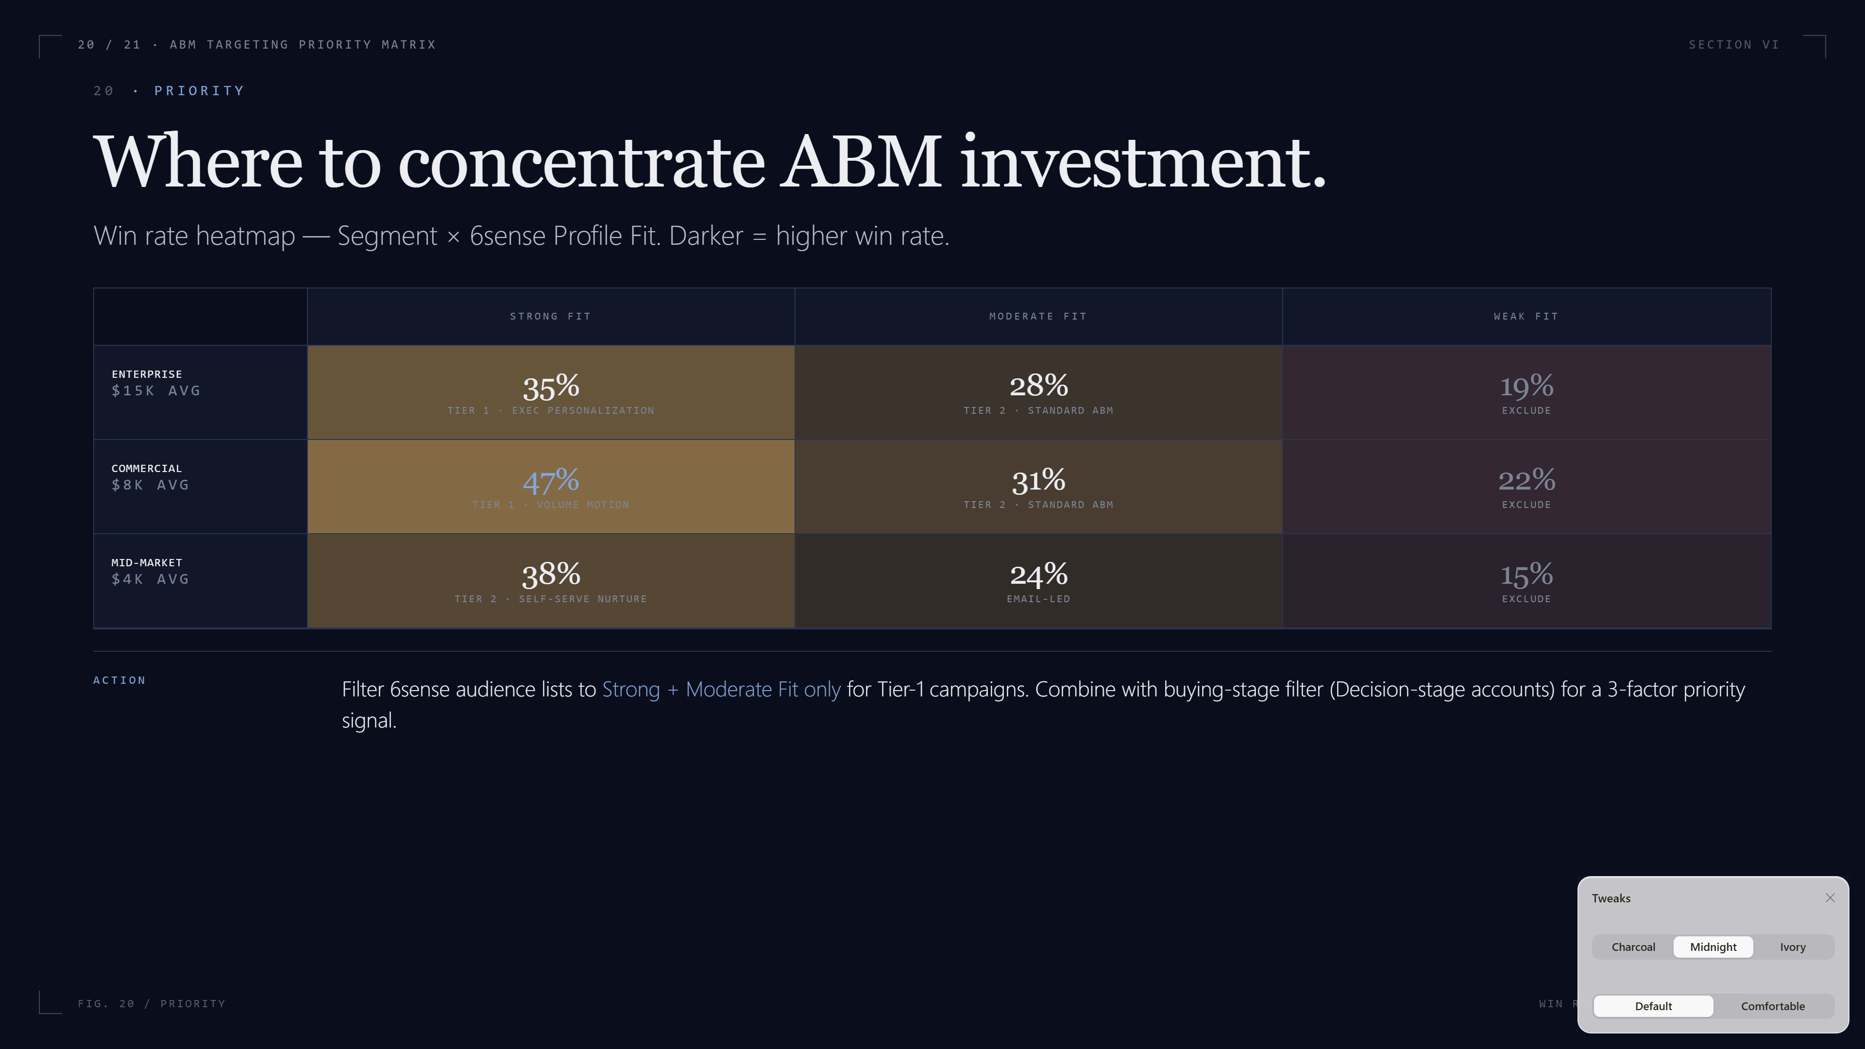
Notes:
The ABM priority matrix. Segment crossed with Profile Fit. Commercial plus Strong is the highest win rate at 47% — that's where the volume motion lives. Enterprise plus Strong has lower win rate but the largest deal size; that's where executive personalization pays off. Weak Profile Fit drops win rates to 15-25% across the board — those accounts shouldn't see Tier 1 budget. Filter audience lists to Strong and Moderate Fit only.

Slide 21
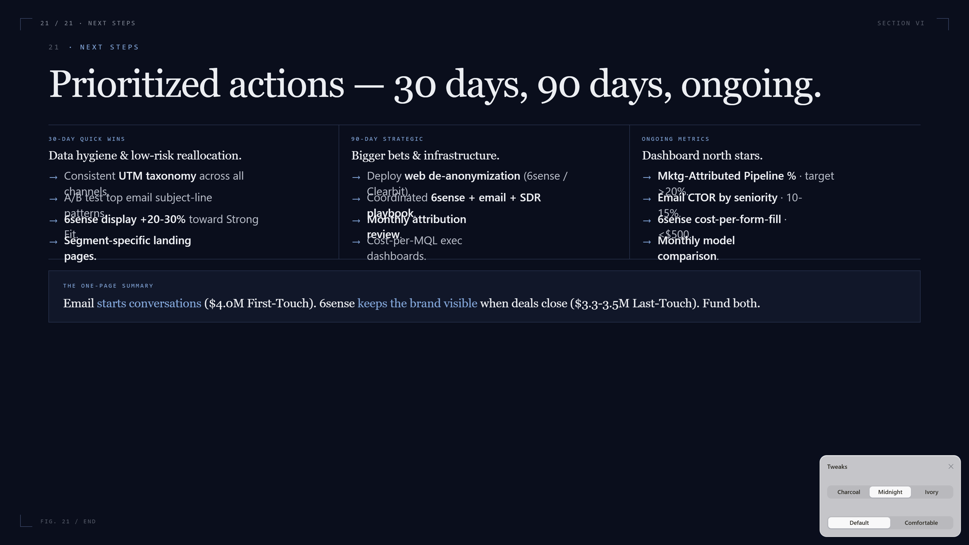
Notes:
To close: prioritized actions. 30-day quick wins are mostly data hygiene and low-risk reallocation — fix UTMs, A/B test subject lines, shift 6sense budget toward Strong Fit accounts. 90-day strategic work is bigger: deploy web de-anonymization, build a coordinated playbook, set up monthly attribution review. The ongoing metrics at the bottom are what we'd put on the executive dashboard. Thank you — happy to take questions.

